Slide 1
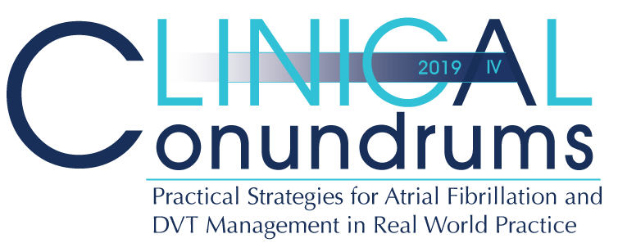



Case 1
CASE 5
Norman
Periprocedural Management of Direct Oral Anticoagulants

Slide 2

Learning Objectives
Upon completion of this activity, participants should be able to:
I
Assess and stratify bleeding risk in patients with AF undergoing different procedures to guide treatment
II
Explain the challenges in bleeding management and stopping/restarting DOACs for a procedure and be familiar with current recommendations
III
Implement best evidence and guidelines for pre, peri, and post procedure DOAC management

Slide 3

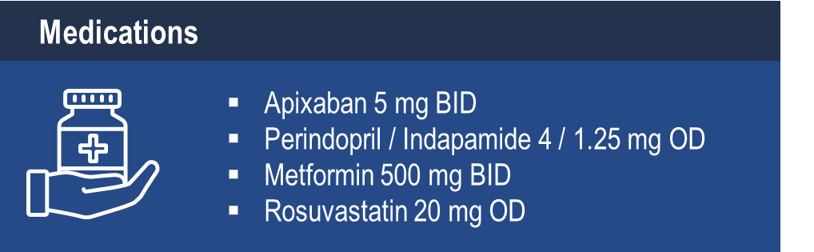
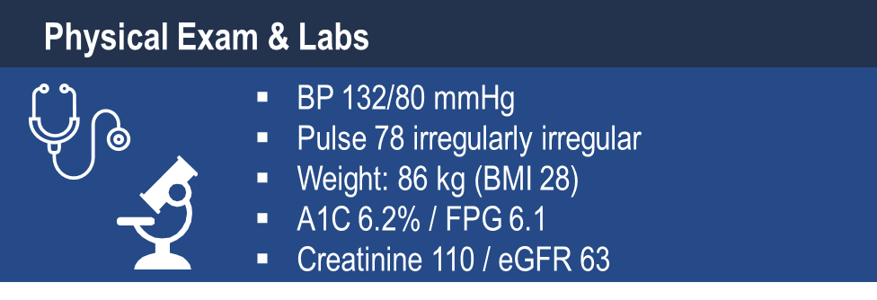
Case 1
Norman
74 years old
Notes:
Speaker Notes:

Slide 4

Case 1
Norman
74 years old
Norman comes to see you for his routine diabetes visit
He also presents you with a pre-op form for his impending cataract surgery and wants to know what he is supposed to do about “his blood thinner” Apixaban 5 mg BID which he has been taking for AF for the last year. He was previously on warfarin for 3 years.
Notes:
Speaker Notes:

Slide 5

What is Norman’s Bleeding Risk for Cataract Removal Surgery ?
Select from one of the following:
Low Risk
Moderate Risk
High Risk
Notes:
Speaker Notes:
Correct Answer: 1 (Low Risk)

Slide 6
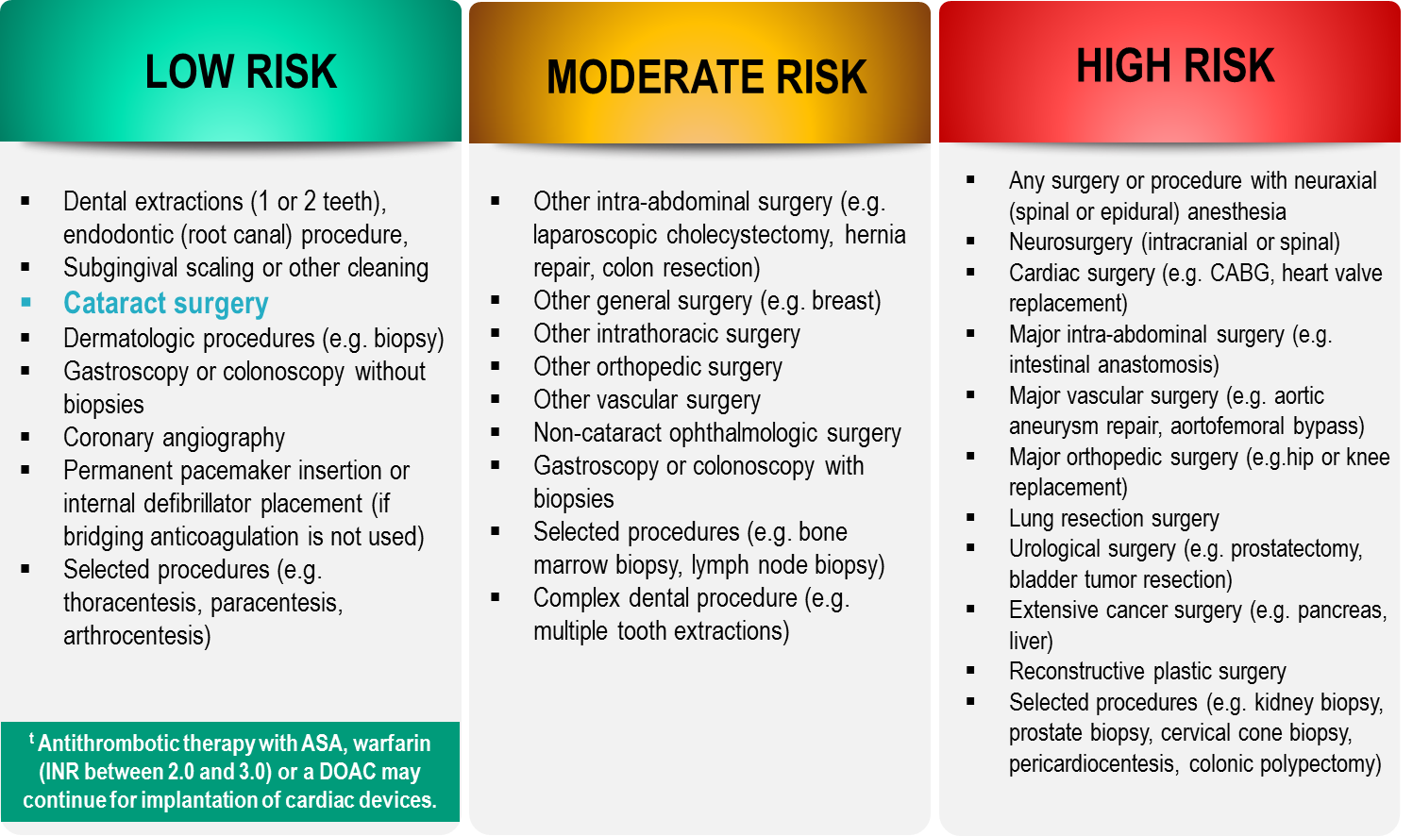
Bleeding Risks for Invasive /
Surgical Procedures
CCS AF Guidelines. Can J Cardiol. 2016; 32: 1170-1185
Thrombosis Canada Clinical Guide. Warfarin: Peri-Operative Management. www.thrombosiscanada.ca
BRUISE-CONTROL 2 – Presented at the AHA Scientific Sessions, Anaheim CA - Nov 2017
Notes:
Speaker Notes:
Steering committee recommendation; In addition to the bleeding risk of a procedure, physicians should consider co-morbid conditions that might exacerbate the bleeding risk (e.g. advanced age, renal or liver impairment).
Many invasive and surgical procedures carry but a very low to low risk of bleeding – DOACs may be held only briefly or even continued without interruption during such procedures as will be discussed in case #2
Antithrombotic therapy with warfarin but not a DOAC can be safely continued pre-post pacemaker or ICD insertion
DOACs never need to be bridged with subcutaneous heparin peri-invasive or surgical procedures due to their short duration of action
REFERENCES:
Douketis JD, Spyropoulos AC, Spencer FA, et al. Perioperative management of antithrombotic therapy: Antithrombotic Therapy and Prevention of Thrombosis, 9th ed: American College of Chest Physicians Evidence-Based Clinical Practice Guidelines. Chest. 2012;141(2 Suppl):e326S - 50S.
Verma A, Cairns JA, Mitchell LB, et al. 2014 focused update of the Canadian Cardiovascular Society
Guidelines for the management of atrial fibrillation. Can J Cardiol. 2014;30(10):1114-1130.
Horlocker TT, Wedel DJ, Rowlingson JC, et al. Regional anesthesia in the patient receiving antithrombotic or thrombolytic therapy: American Society of Regional Anesthesia and Pain Medicine Evidence-Based Guidelines (Third Edition). Reg Anesth Pain Med. 2010;35(1):64-101.
XARELTO-PM-ENG-10JUL2014-172618.pdf. http://www.bayer.ca/files/XARELTO-PM-ENG-10JUL2014-
172618.pdf? Accessed 11 Nov 2014
Pfizer Canada Inc Eliquis Product Monograph. http://www.pfizer.ca/en/our_products/products/monograph/313. Accessed 11 Nov 2014
Boehringer Ingelheim Canada Ltd. (2014) Pradaxa Product Monograph. http://www.boehringer- ingelheim.ca/content/dam/internet/opu/ca_EN/documents/humanhealth/product_monograph/Prad axaPMEN.pdf. Accessed 11 Nov 2014
Thrombosis Canada. http://thrombosiscanada.ca/

Slide 7
What would you advise Norman to do about his Apixaban for Cataract Removal Surgery?
Select from one of the following:
Continue his Apixaban
Suspend the dose on the day of surgery (take it after the procedure)
Skip 2 doses of Apixaban (i.e. last dose day -2)
Skip 4 doses of Apixaban (i.e. last dose day -3)
Stop Apixaban 5 days pre-operatively
Notes:
Speaker Notes:
Correct Answer: 1 (Continue his Apixaban)
SPC Additional Expert Opinion: This is my personal recommendation for suspending the DOAC morning dose until after low bleeding risk procedures along with an effort to obtain an early morning appointment .

Slide 8

CCS 2016 Clinical
Practice Recommendations
RECOMMENDATION
We suggest that interruption of anticoagulant therapy, particularly for VKAs, in a patient with AF/AFL is not necessary for most procedures with a low risk of bleeding, such as cardiac device implantation (pacemaker or implantable defibrillator), and most dental procedures
AF = Atrial Fibrillation
AFL = Atrial Flutter
(Conditional Recommendation, Moderate-Quality Evidence)
2016 Focused Update of the Canadian Cardiovascular Society Guidelines for the Management of Atrial Fibrillation
Macle, Laurent et al. Canadian Journal of Cardiology , Volume 32 , Issue 10 , 1170 - 1185
Notes:
Speaker Notes:

Slide 9

Selection of Invasive /
Surgical Procedures
Colonoscopy with Possible Polypectomy
Go to Key Messages
Elective Cholecystectomy
Radical Prostatectomy for Prostate Cancer
AAA Repair with Renal Impairment
Notes:
Speaker Notes:

Slide 10
Case 1 What If….
Norman
74 years old
Norman is now on Rivaroxaban
He presents you with a pre-op form for his impending Colonoscopy with Possible Polypectomy and wants to know what he is supposed to do about “his blood thinner” Rivaroxaban 20 mg OD
Notes:
Speaker Notes:

Slide 11
What is Norman’s Bleeding Risk for Colonoscopy with Possible Polypectomy?
Rx: Rivaroxaban 20 mg OD
Select from one of the following:
Low Risk
Moderate Risk
High Risk
Notes:
Speaker Notes:
Correct Answer: 3 (High Risk)

Slide 12
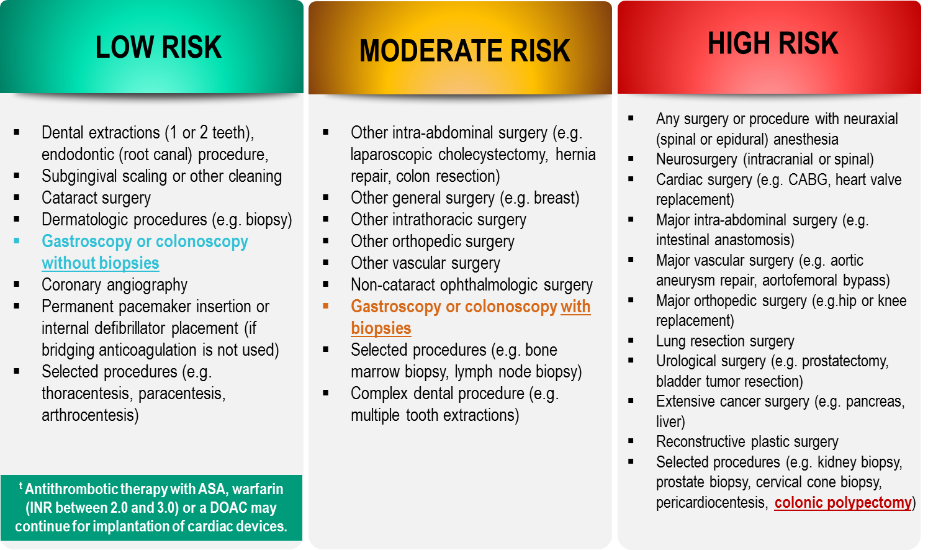
Bleeding Risks for Invasive /
Surgical Procedures
CCS AF Guidelines. Can J Cardiol. 2016; 32: 1170-1185
Thrombosis Canada Clinical Guide. Warfarin: Peri-Operative Management. www.thrombosiscanada.ca
BRUISE-CONTROL 2 – Presented at the AHA Scientific Sessions, Anaheim CA - Nov 2017
Notes:
Speaker Notes:
Highlight "Gastroscopy or colonoscopy without biopsy" for speaker to point out that bleeding risk is low in this setting as it is with a TEE (transesophageal echocardiogram). It is the occasional and unpredictable need for a biopsy or polypectomy that increases the procedure's bleeding risk
Steering committee recommendation; In addition to the bleeding risk of a procedure, physicians should consider co-morbid conditions that might exacerbate the bleeding risk (e.g. advanced age, renal or liver impairment).
Many invasive and surgical procedures carry but a very low to low risk of bleeding – DOACs may be held only briefly or even continued without interruption during such procedures as will be discussed in case #2
Antithrombotic therapy with warfarin but not a DOAC can be safely continued pre-post pacemaker or ICD insertion
DOACs never need to be bridged with subcutaneous heparin peri-invasive or surgical procedures due to their short duration of action
REFERENCES:
Douketis JD, Spyropoulos AC, Spencer FA, et al. Perioperative management of antithrombotic therapy: Antithrombotic Therapy and Prevention of Thrombosis, 9th ed: American College of Chest Physicians Evidence-Based Clinical Practice Guidelines. Chest. 2012;141(2 Suppl):e326S - 50S.
Verma A, Cairns JA, Mitchell LB, et al. 2014 focused update of the Canadian Cardiovascular Society
Guidelines for the management of atrial fibrillation. Can J Cardiol. 2014;30(10):1114-1130.
Horlocker TT, Wedel DJ, Rowlingson JC, et al. Regional anesthesia in the patient receiving antithrombotic or thrombolytic therapy: American Society of Regional Anesthesia and Pain Medicine Evidence-Based Guidelines (Third Edition). Reg Anesth Pain Med. 2010;35(1):64-101.
XARELTO-PM-ENG-10JUL2014-172618.pdf. http://www.bayer.ca/files/XARELTO-PM-ENG-10JUL2014-
172618.pdf? Accessed 11 Nov 2014
Pfizer Canada Inc Eliquis Product Monograph. http://www.pfizer.ca/en/our_products/products/monograph/313. Accessed 11 Nov 2014
Boehringer Ingelheim Canada Ltd. (2014) Pradaxa Product Monograph. http://www.boehringer- ingelheim.ca/content/dam/internet/opu/ca_EN/documents/humanhealth/product_monograph/Prad axaPMEN.pdf. Accessed 11 Nov 2014
Thrombosis Canada. http://thrombosiscanada.ca/

Slide 13
What would you advise Norman to do about to do about his Rivaroxaban for his Colonoscopy with Possible Polypectomy ?
Select from one of the following:
Continue his Rivaroxaban
Suspend the dose on the day of surgery (take it after the procedure)
Skip 1 dose of Rivaroxaban (i.e. last dose day -2)
Skip 2 doses of Rivaroxaban (i.e. last dose day -3)
Stop Rivaroxaban 5 days pre-operatively
Notes:
Speaker Notes:
Correct Answer: 3 (Skip 1 dose of Rivaroxaban (i.e. last dose day -2)

Slide 14
CCS 2016 Clinical
Practice Recommendations
RECOMMENDATION
We recommend that the interruption of anticoagulant therapy in a patient with AF/AFL will be necessary for most procedures with an intermediate or high risk of major bleeding
(Strong Recommendation, Low-Quality Evidence)
AF = Atrial Fibrillation
AFL = Atrial Flutter
2016 Focused Update of the Canadian Cardiovascular Society Guidelines for the Management of Atrial Fibrillation
Macle, Laurent et al. Canadian Journal of Cardiology , Volume 32 , Issue 10 , 1170 - 1185
Notes:
Speaker Notes:

Slide 15
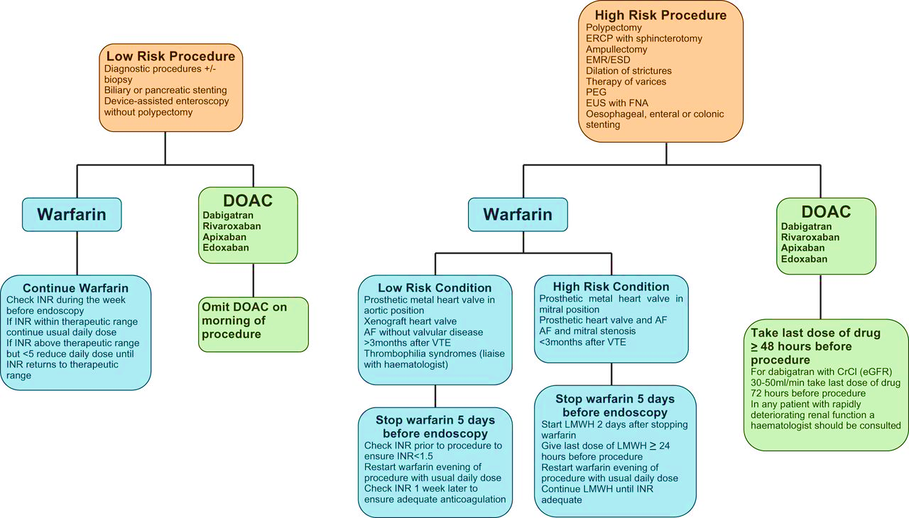
Guidelines For The Management Of Patients On Warfarin Or Direct Oral Anticoagulants (DOAC) Undergoing Endoscopic Procedures
British Society Of Gastroenterology (BSG) &
European Society Of Gastrointestinal Endoscopy (ESGE) Guidelines
Veitch AM, Vanbiervliet G, Gershlick AH, et al Endoscopy in patients on antiplatelet or anticoagulant therapy, including direct oral anticoagulants: British Society of Gastroenterology (BSG) and European Society of Gastrointestinal Endoscopy (ESGE) guidelines Gut 2016;65:374-389.
Notes:
Speaker Notes:
Abstract
The risk of endoscopy in patients on antithrombotics depends on the risks of procedural haemorrhage versus thrombosis due to discontinuation of therapy.
P2Y12 receptor antagonists (clopidogrel, prasugrel, ticagrelor) For low-risk endoscopic procedures we recommend continuing P2Y12 receptor antagonists as single or dual antiplatelet therapy (low quality evidence, strong recommendation); For high-risk endoscopic procedures in patients at low thrombotic risk, we recommend discontinuing P2Y12 receptor antagonists five days before the procedure (moderate quality evidence, strong recommendation). In patients on dual antiplatelet therapy, we suggest continuing aspirin (low quality evidence, weak recommendation). For high-risk endoscopic procedures in patients at high thrombotic risk, we recommend continuing aspirin and liaising with a cardiologist about the risk/benefit of discontinuation of P2Y12 receptor antagonists (high quality evidence, strong recommendation).
Warfarin The advice for warfarin is fundamentally unchanged from British Society of Gastroenterology (BSG) 2008 guidance.
Direct Oral Anticoagulants (DOAC) For low-risk endoscopic procedures we suggest omitting the morning dose of DOAC on the day of the procedure (very low quality evidence, weak recommendation); For high-risk endoscopic procedures, we recommend that the last dose of DOAC be taken ≥48 h before the procedure (very low quality evidence, strong recommendation). For patients on dabigatran with CrCl (or estimated glomerular filtration rate, eGFR) of 30–50 mL/min we recommend that the last dose of DOAC be taken 72 h before the procedure (very low quality evidence, strong recommendation). In any patient with rapidly deteriorating renal function a haematologist should be consulted (low quality evidence, strong recommendation).
For all endoscopic procedures we recommend continuing aspirin (moderate evidence, strong recommendation), with the exception of endoscopic submucosal dissection (ESD), large colonic endoscopic mucosal resection (EMR) (>2 cm), upper gastrointestinal EMR and ampullectomy. In the latter cases, aspirin discontinuation should be considered on an individual patient basis depending on the risks of thrombosis versus haemorrhage (low quality evidence, weak recommendation).
1.1 Low-risk procedures
For low-risk endoscopic procedures we recommend continuing P2Y12 receptor antagonists (eg, clopidogrel), as single or dual antiplatelet therapy (low quality evidence, strong recommendation).
For low-risk endoscopic procedures we suggest that warfarin therapy should be continued (low quality evidence, weak recommendation). It should be ensured that the International normalised ratio (INR) does not exceed the therapeutic range in the week prior to the procedure (low quality evidence, strong recommendation).
For low-risk endoscopic procedures we suggest omitting the morning dose of DOACs on the day of the procedure (very low quality evidence, weak recommendation)
1.2 High-risk procedures
For high-risk endoscopic procedures in patients at low thrombotic risk, we recommend discontinuing P2Y12 receptor antagonists (eg, clopidogrel) five days before the procedure (moderate quality evidence, strong recommendation). In patients on dual antiplatelet therapy, we suggest continuing aspirin (low quality evidence, weak recommendation).
For high-risk endoscopic procedures in patients at low thrombotic risk, we recommend discontinuing warfarin 5 days before the procedure (high quality evidence, strong recommendation). Check INR prior to the procedure to ensure <1.5 (low quality evidence, strong recommendation).
For high-risk endoscopic procedures in patients at high thrombotic risk, we recommend continuing aspirin and liaising with a cardiologist about the risk/benefit of discontinuing P2Y12 receptor antagonists (eg, clopidogrel) (high quality evidence, strong recommendation).
For high-risk endoscopic procedures in patients at high thrombotic risk, we recommend that warfarin should be temporarily discontinued and substituted with low molecular weight heparin (LMWH) (low quality evidence, strong recommendation).
For all patients on warfarin we recommend advising that there is an increased risk of post-procedure bleeding compared to non-anticoagulated patients (low quality evidence, strong recommendation).
For high-risk endoscopic procedures in patients on DOACs, we recommend that the last dose of DOACs be taken at least 48 h before the procedure (very low quality evidence, strong recommendation). For patients on dabigatran with a CrCl (or estimated glomerular filtration rate (eGFR)) of 30–50 mL/min we recommend that the last dose be taken 72 h prior to the procedure (very low quality evidence, strong recommendation). In any patient with rapidly deteriorating renal function a haematologist should be consulted (low quality evidence, strong recommendation).
1.3 Post endoscopic procedure
If antiplatelet or anticoagulant therapy is discontinued, then we recommend this should be resumed up to 48 h after the procedure depending on the perceived bleeding and thrombotic risks (moderate quality evidence, strong recommendation).

Slide 16
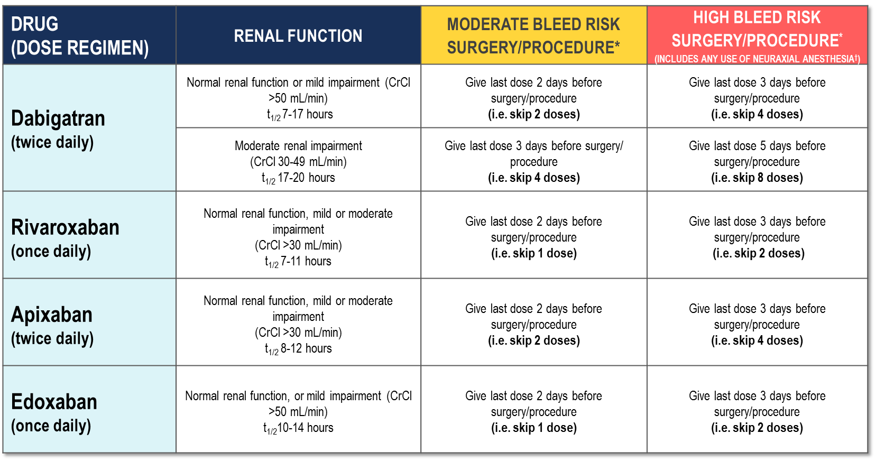
Peri-Operative Guide
*No anticoagulant taken on the day of surgery/procedure.
†Neuraxial procedures include spinal anesthesia, epidural catheter insertion and epidural catheter removal.
2017 Thrombosis Canada
Notes:
Speaker Notes:
Patients with Impaired Renal Function: For patients with severe renal dysfunction (CrCl <30 mL/min) who are generally ineligible for DOACs, peri-operative management is unclear.

Slide 17
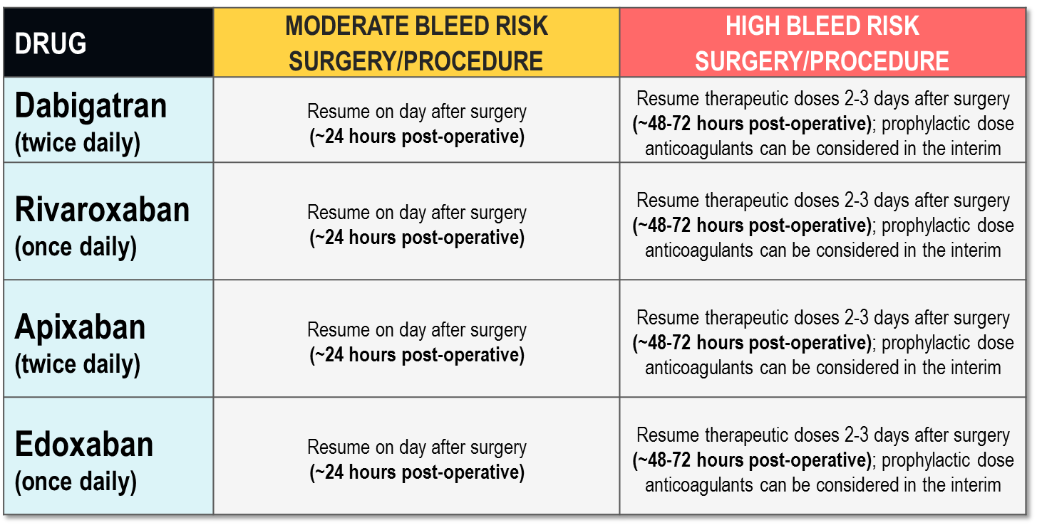
Post-Operative Guide
2017 Thrombosis Canada
Notes:
Speaker Notes:

Slide 18
Case 1 What If….
Norman
74 years old
Norman is now on Dabigatran
He is having Elective Cholecystectomy and wants to know what he is supposed to do about “his blood thinner” Dabigitran 150 mg BID
Notes:
Speaker Notes:

Slide 19
What is Norman’s Bleeding Risk for Elective Cholecystectomy ?
Rx: Dabigatran 150 mg BID
Select from one of the following:
Low Risk
Moderate Risk
High Risk
Notes:
Speaker Notes:
Correct Answer: 2 (Moderate Risk)

Slide 20
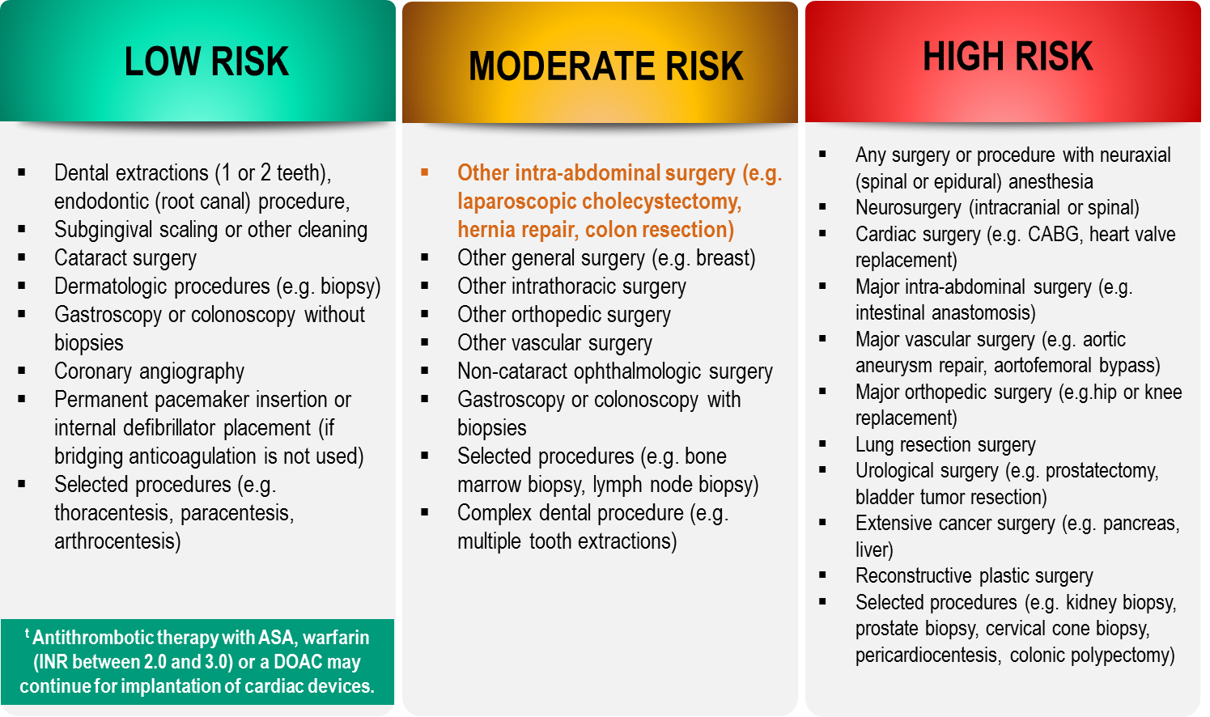
Bleeding Risks for Invasive /
Surgical Procedures
CCS AF Guidelines. Can J Cardiol. 2016; 32: 1170-1185
Thrombosis Canada Clinical Guide. Warfarin: Peri-Operative Management. www.thrombosiscanada.ca
BRUISE-CONTROL 2 – Presented at the AHA Scientific Sessions, Anaheim CA - Nov 2017
Notes:
Speaker Notes:
Steering committee recommendation; In addition to the bleeding risk of a procedure, physicians should consider co-morbid conditions that might exacerbate the bleeding risk (e.g. advanced age, renal or liver impairment).
Many invasive and surgical procedures carry but a very low to low risk of bleeding – DOACs may be held only briefly or even continued without interruption during such procedures as will be discussed in case #2
Antithrombotic therapy with warfarin but not a DOAC can be safely continued pre-post pacemaker or ICD insertion
DOACs never need to be bridged with subcutaneous heparin peri-invasive or surgical procedures due to their short duration of action
REFERENCES:
Douketis JD, Spyropoulos AC, Spencer FA, et al. Perioperative management of antithrombotic therapy: Antithrombotic Therapy and Prevention of Thrombosis, 9th ed: American College of Chest Physicians Evidence-Based Clinical Practice Guidelines. Chest. 2012;141(2 Suppl):e326S - 50S.
Verma A, Cairns JA, Mitchell LB, et al. 2014 focused update of the Canadian Cardiovascular Society
Guidelines for the management of atrial fibrillation. Can J Cardiol. 2014;30(10):1114-1130.
Horlocker TT, Wedel DJ, Rowlingson JC, et al. Regional anesthesia in the patient receiving antithrombotic or thrombolytic therapy: American Society of Regional Anesthesia and Pain Medicine Evidence-Based Guidelines (Third Edition). Reg Anesth Pain Med. 2010;35(1):64-101.
XARELTO-PM-ENG-10JUL2014-172618.pdf. http://www.bayer.ca/files/XARELTO-PM-ENG-10JUL2014-
172618.pdf? Accessed 11 Nov 2014
Pfizer Canada Inc Eliquis Product Monograph. http://www.pfizer.ca/en/our_products/products/monograph/313. Accessed 11 Nov 2014
Boehringer Ingelheim Canada Ltd. (2014) Pradaxa Product Monograph. http://www.boehringer- ingelheim.ca/content/dam/internet/opu/ca_EN/documents/humanhealth/product_monograph/Prad axaPMEN.pdf. Accessed 11 Nov 2014
Thrombosis Canada. http://thrombosiscanada.ca/

Slide 21
What would you advise Norman to do about to do about his Dabigatran for his Elective Cholecystectomy?
Select from one of the following:
Continue his Dabigitran
Suspend the dose on the day of surgery (take it after the procedure)
Skip 2 doses of Dabigitran (i.e. last dose day -2)
Skip 4 doses of Dabigitran (i.e. last dose day -3)
Stop Dabigitran 5 days pre-operatively
Notes:
Speaker Notes:
Correct Answer: 3 (Skip 2 doses of Dabigitran (i.e. last dose day -2)

Slide 22
CCS 2016 Clinical
Practice Recommendations
RECOMMENDATION
We recommend that the interruption of anticoagulant therapy in a patient with AF/AFL will be necessary for most procedures with an intermediate or high risk of major bleeding
(Strong Recommendation, Low-Quality Evidence)
AF = Atrial Fibrillation
AFL = Atrial Flutter
2016 Focused Update of the Canadian Cardiovascular Society Guidelines for the Management of Atrial Fibrillation
Macle, Laurent et al. Canadian Journal of Cardiology , Volume 32 , Issue 10 , 1170 - 1185
Notes:
Speaker Notes:

Slide 23
Peri-Operative Guide
*No anticoagulant taken on the day of surgery/procedure.
†Neuraxial procedures include spinal anesthesia, epidural catheter insertion and epidural catheter removal.
2017 Thrombosis Canada
Notes:
Speaker Notes:
Patients with Impaired Renal Function: For patients with severe renal dysfunction (CrCl <30 mL/min) who are generally ineligible for DOACs, peri-operative management is unclear.

Slide 24
Post-Operative Guide
2017 Thrombosis Canada
Notes:
Speaker Notes:

Slide 25
Case 1 What If….
Norman
74 years old
Norman is now on Edoxaban
He requires a Radical Prostatectomy for Prostate Cancer and wants to know what he is supposed to do about “his blood thinner” Edoxaban 60 mg OD
Notes:
Speaker Notes:

Slide 26
What is Norman’s Bleeding Risk for Radical Prostatectomy for Prostate Cancer?
Rx: Edoxaban 60 mg OD
Select from one of the following:
Low Risk
Moderate Risk
High Risk
Notes:
Speaker Notes:
Correct Answer: 3 (High Risk)

Slide 27
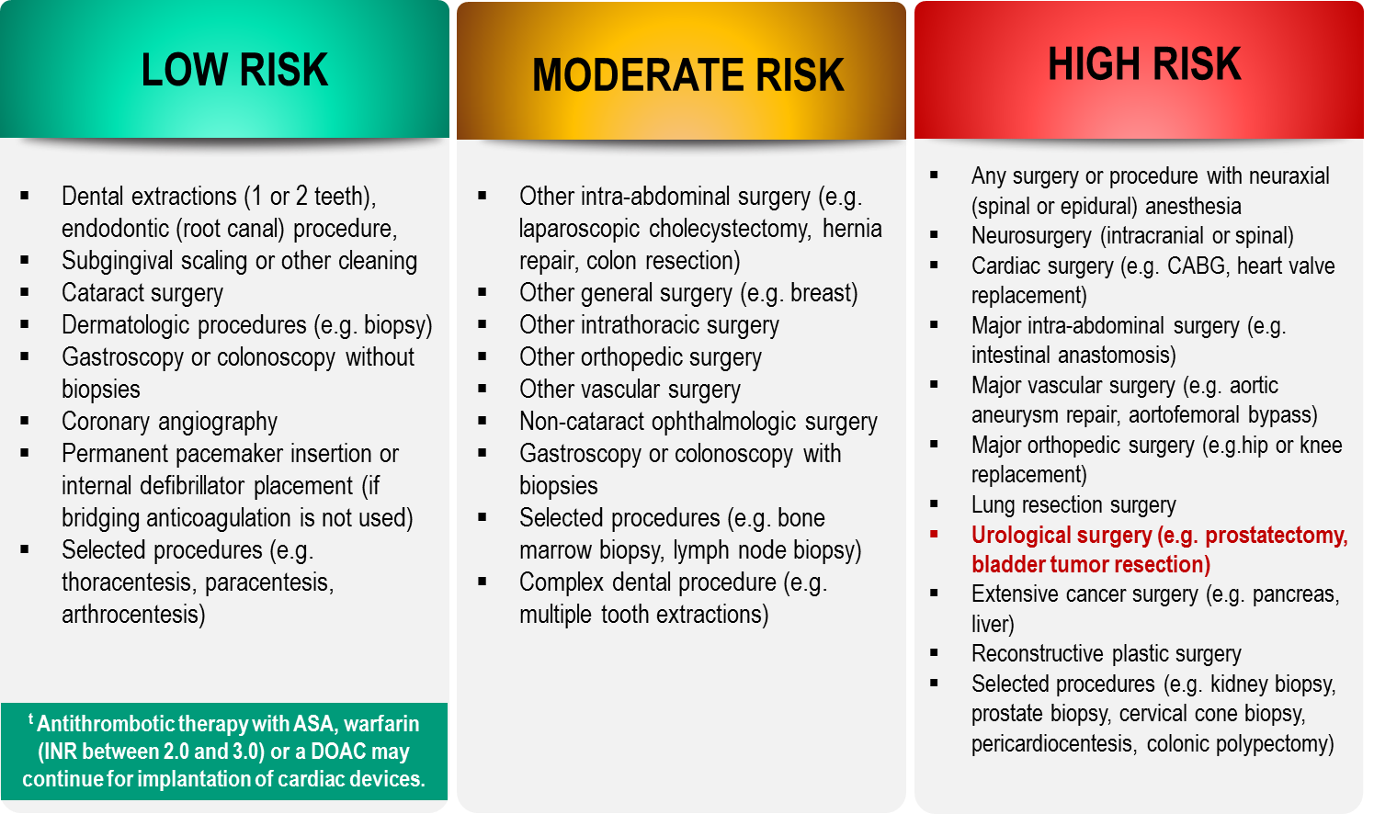
Bleeding Risks for Invasive /
Surgical Procedures
CCS AF Guidelines. Can J Cardiol. 2016; 32: 1170-1185
Thrombosis Canada Clinical Guide. Warfarin: Peri-Operative Management. www.thrombosiscanada.ca
BRUISE-CONTROL 2 – Presented at the AHA Scientific Sessions, Anaheim CA - Nov 2017
Notes:
Speaker Notes:
Steering committee recommendation; In addition to the bleeding risk of a procedure, physicians should consider co-morbid conditions that might exacerbate the bleeding risk (e.g. advanced age, renal or liver impairment).
Many invasive and surgical procedures carry but a very low to low risk of bleeding – DOACs may be held only briefly or even continued without interruption during such procedures as will be discussed in case #2
Antithrombotic therapy with warfarin but not a DOAC can be safely continued pre-post pacemaker or ICD insertion
DOACs never need to be bridged with subcutaneous heparin peri-invasive or surgical procedures due to their short duration of action
REFERENCES:
Douketis JD, Spyropoulos AC, Spencer FA, et al. Perioperative management of antithrombotic therapy: Antithrombotic Therapy and Prevention of Thrombosis, 9th ed: American College of Chest Physicians Evidence-Based Clinical Practice Guidelines. Chest. 2012;141(2 Suppl):e326S - 50S.
Verma A, Cairns JA, Mitchell LB, et al. 2014 focused update of the Canadian Cardiovascular Society
Guidelines for the management of atrial fibrillation. Can J Cardiol. 2014;30(10):1114-1130.
Horlocker TT, Wedel DJ, Rowlingson JC, et al. Regional anesthesia in the patient receiving antithrombotic or thrombolytic therapy: American Society of Regional Anesthesia and Pain Medicine Evidence-Based Guidelines (Third Edition). Reg Anesth Pain Med. 2010;35(1):64-101.
XARELTO-PM-ENG-10JUL2014-172618.pdf. http://www.bayer.ca/files/XARELTO-PM-ENG-10JUL2014-
172618.pdf? Accessed 11 Nov 2014
Pfizer Canada Inc Eliquis Product Monograph. http://www.pfizer.ca/en/our_products/products/monograph/313. Accessed 11 Nov 2014
Boehringer Ingelheim Canada Ltd. (2014) Pradaxa Product Monograph. http://www.boehringer- ingelheim.ca/content/dam/internet/opu/ca_EN/documents/humanhealth/product_monograph/Prad axaPMEN.pdf. Accessed 11 Nov 2014
Thrombosis Canada. http://thrombosiscanada.ca/

Slide 28
What would you advise Norman to do about to do about his Edoxaban for his Radical Prostatectomy for Prostate Cancer?
Select from one of the following:
Continue his Edoxaban
Suspend the dose on the day of surgery (take it after the procedure)
Skip 1 dose of Edoxaban (i.e. last dose day -2)
Skip 2 doses of Edoxaban (i.e. last dose day -3)
Stop Edoxaban 5 days pre-operatively
Notes:
Speaker Notes:
Correct Answer: 4 (Skip 2 doses of Edoxaban (i.e. last dose day -3)

Slide 29
CCS 2016 Clinical
Practice Recommendations
RECOMMENDATION
We recommend that the interruption of anticoagulant therapy in a patient with AF/AFL will be necessary for most procedures with an intermediate or high risk of major bleeding
(Strong Recommendation, Low-Quality Evidence)
AF = Atrial Fibrillation
AFL = Atrial Flutter
2016 Focused Update of the Canadian Cardiovascular Society Guidelines for the Management of Atrial Fibrillation
Macle, Laurent et al. Canadian Journal of Cardiology , Volume 32 , Issue 10 , 1170 - 1185
Notes:
Speaker Notes:

Slide 30
Peri-Operative Guide
*No anticoagulant taken on the day of surgery/procedure.
†Neuraxial procedures include spinal anesthesia, epidural catheter insertion and epidural catheter removal.
2017 Thrombosis Canada
Notes:
Speaker Notes:
Patients with Impaired Renal Function: For patients with severe renal dysfunction (CrCl <30 mL/min) who are generally ineligible for DOACs, peri-operative management is unclear.

Slide 31
Post-Operative Guide
2017 Thrombosis Canada
Notes:
Speaker Notes:

Slide 32

Case 1 What If….
Norman
81 years old
Norman is now 81 years old and is on reduced dose Apixaban
He requires an AAA repair.
Norman’s eGFR is 44 and Creatinine is 140. He wants to know what he is supposed to do about “his blood thinner” Apixaban 2.5 mg BID
Notes:
Speaker Notes:

Slide 33
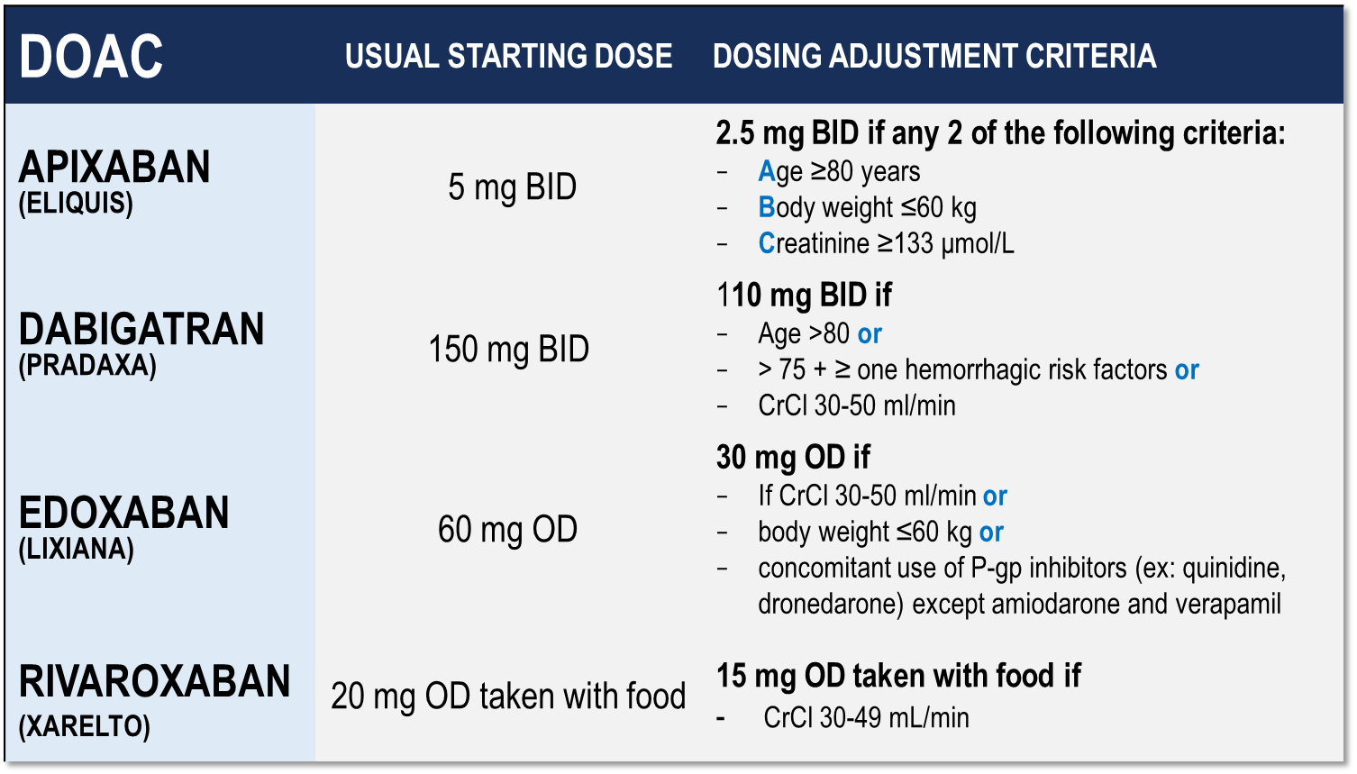
Considerations for Dosing of DOACs
Pfizer Canada Inc./BMS Canada. Eliquis (apixaban) Product Monograph, 2018.
Boehringer Ingelheim Canada Ltd. Pradaxa (dagbatran) Product Monograph. August 11, 2016.
Bayer Inc. Xarelto (rivaroxaban) Product Monograph. 2018.
Daiichi Sankyp Inc. Lixiana (edoxaban) Product Monograph. 2017.
Notes:
Speaker Notes:
Indispensable slide summarizing the criteria for a dosage adjustment from the default higher dosage for the different DOACs currently available in Canada
The dosing adjustments proposed for apixaban, edoxaban and rivaroxaban are those utilized to the dosage of selected patients enrolled in the respective prospective clinical trials (ARISTOTLE, ENGAGE and ROCKET-AF). The overall goal was to achieve a stable plasma concentration in subjects assigned to DOAC therapy in these studies.
The speaker should emphasize that the RELY study, in fact, tested two separate dosages of dabigatran (150 mg and 110 mg BID) independently against warfarin, without a pre-specified dosage reduction algorithm for reduced renal function. Since dabigatran is known to be 85% renally cleared, the Canadian AF Guidelines Committee subsequently proposed dosing adjustments (as did all other guideline committees), as listed in the table, for elderly patients and those with stage 3 renal dysfunction in order to minimize the risk of drug accumulation and bleeding in these patients.

Slide 34
What is Norman’s Bleeding Risk for the AAA repair?
Rx: Apixaban 2.5 mg BID
Select from one of the following:
Low Risk
Moderate Risk
High Risk
Notes:
Speaker Notes:
Correct Answer: 3 (High Risk)

Slide 35

Bleeding Risks for Invasive /
Surgical Procedures
CCS AF Guidelines. Can J Cardiol. 2016; 32: 1170-1185
Thrombosis Canada Clinical Guide. Warfarin: Peri-Operative Management. www.thrombosiscanada.ca
BRUISE-CONTROL 2 – Presented at the AHA Scientific Sessions, Anaheim CA - Nov 2017
Notes:
Speaker Notes:
Steering committee recommendation; In addition to the bleeding risk of a procedure, physicians should consider co-morbid conditions that might exacerbate the bleeding risk (e.g. advanced age, renal or liver impairment).
Many invasive and surgical procedures carry but a very low to low risk of bleeding – DOACs may be held only briefly or even continued without interruption during such procedures as will be discussed in case #2
Antithrombotic therapy with warfarin but not a DOAC can be safely continued pre-post pacemaker or ICD insertion
DOACs never need to be bridged with subcutaneous heparin peri-invasive or surgical procedures due to their short duration of action
REFERENCES:
Douketis JD, Spyropoulos AC, Spencer FA, et al. Perioperative management of antithrombotic therapy: Antithrombotic Therapy and Prevention of Thrombosis, 9th ed: American College of Chest Physicians Evidence-Based Clinical Practice Guidelines. Chest. 2012;141(2 Suppl):e326S - 50S.
Verma A, Cairns JA, Mitchell LB, et al. 2014 focused update of the Canadian Cardiovascular Society
Guidelines for the management of atrial fibrillation. Can J Cardiol. 2014;30(10):1114-1130.
Horlocker TT, Wedel DJ, Rowlingson JC, et al. Regional anesthesia in the patient receiving antithrombotic or thrombolytic therapy: American Society of Regional Anesthesia and Pain Medicine Evidence-Based Guidelines (Third Edition). Reg Anesth Pain Med. 2010;35(1):64-101.
XARELTO-PM-ENG-10JUL2014-172618.pdf. http://www.bayer.ca/files/XARELTO-PM-ENG-10JUL2014-
172618.pdf? Accessed 11 Nov 2014
Pfizer Canada Inc Eliquis Product Monograph. http://www.pfizer.ca/en/our_products/products/monograph/313. Accessed 11 Nov 2014
Boehringer Ingelheim Canada Ltd. (2014) Pradaxa Product Monograph. http://www.boehringer- ingelheim.ca/content/dam/internet/opu/ca_EN/documents/humanhealth/product_monograph/Prad axaPMEN.pdf. Accessed 11 Nov 2014
Thrombosis Canada. http://thrombosiscanada.ca/

Slide 36
What would you advise Norman to do about to do about his Apixaban for his AAA repair surgery?
Select from one of the following:
Continue his Apixaban
Suspend the dose on the day of surgery (take it after the procedure)
Skip 2 doses of Apixaban (i.e. last dose day -2)
Skip 4 doses of Apixaban (i.e. last dose day -3)
Stop Apixaban pre-operatively
Notes:
Speaker Notes:
Correct Answer: 4 (Skip 4 doses of Apixaban (i.e. last dose day -3)

Slide 37
CCS 2016 Clinical
Practice Recommendations
RECOMMENDATION
We recommend that the interruption of anticoagulant therapy in a patient with AF/AFL will be necessary for most procedures with an intermediate or high risk of major bleeding
(Strong Recommendation, Low-Quality Evidence)
AF = Atrial Fibrillation
AFL = Atrial Flutter
2016 Focused Update of the Canadian Cardiovascular Society Guidelines for the Management of Atrial Fibrillation
Macle, Laurent et al. Canadian Journal of Cardiology , Volume 32 , Issue 10 , 1170 - 1185
Notes:
Speaker Notes:

Slide 38
Peri-Operative Guide
*No anticoagulant taken on the day of surgery/procedure.
†Neuraxial procedures include spinal anesthesia, epidural catheter insertion and epidural catheter removal.
2017 Thrombosis Canada
Notes:
Speaker Notes:
Patients with Impaired Renal Function: For patients with severe renal dysfunction (CrCl <30 mL/min) who are generally ineligible for DOACs, peri-operative management is unclear.

Slide 39
Post-Operative Guide
2017 Thrombosis Canada
Notes:
Speaker Notes:

Slide 40

Key Messages
SPAF is of utmost importance and must be considered when optimizing peri-procedural bleeding risk
Patients on anticoagulants will frequently require invasive procedures and surgical interventions
The decision on what to do need not be complicated and depends on:
The type of procedure planned and its related bleeding risk
Consideration of the specific anticoagulant used by the patient
Knowledge of the patient’s renal function
Pre and post operative dosing algorithms created by Thrombosis Canada and the CCS guidelines along with product monographs are helpful resources for the peri-procedural management of DOACs
SPAF = Stroke Prevention in Atrial Fibrillation
Notes:
Speaker Notes:
SPAF = Stroke Prevention in Atrial Fibrillation
Estimation of DOAC levels (e.g. Hemoclot for dabigatran, calibrated chronometric anti-X measurements for apixaban, rivaroxaban and edoxaban) while increasingly available are NOT generally required or useful to guide periprocedural DOAC management

